Slide 1

Information Retrieval Chapter 3: Retrieval Models TY B.Sc. (CS)
Semester VI
Poornima .N
Assistant Professor, Department of IT/CS
1

Slide 2

2 Topics:
Boolean model
Vector space model
Probabilistic model
“Ever wondered how Google decides which pages to show first?” 🤔

Slide 3
3 Introduction to Retrieval Models?
A retrieval model defines how documents and queries are represented and compared to find relevant results.

Slide 4
4 Boolean Model
The Boolean Model is the simplest information retrieval model where documents and queries are represented as sets of terms, and retrieval is based on exact matching using Boolean logic (AND, OR, NOT).
A document is either retrieved (relevant) or not retrieved (irrelevant) — there is no ranking of results.

Slide 5
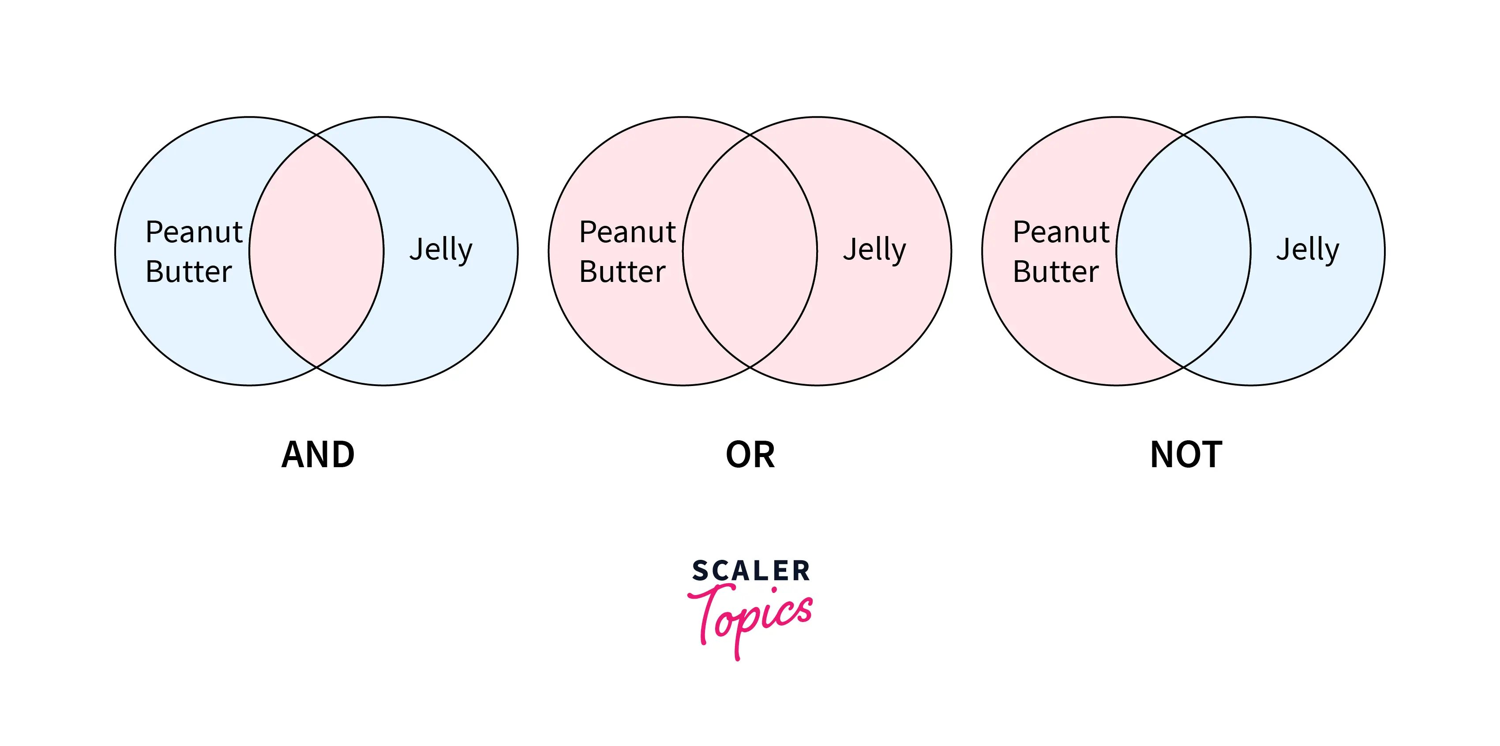

Slide 6
Activity – Boolean Model Practice
Documents:
D1: cats love milk and fish
D2: dogs bark at night
D3: cats and dogs play together
D4: cats chase rats
No. | Query | (Which Docs?)
1️⃣ | cat AND dog | ……………………
2️⃣ | cat OR dog | ……………………
3️⃣ | cat NOT dog | ……………………

Slide 7
5 Vector Space Model (VSM)
The Vector Space Model (VSM) represents documents and queries as vectors in a multi-dimensional space, where each dimension corresponds to a term.
It allows ranking of documents by how close they are to the query.

Slide 8
6 Steps in Vector Space Model (VSM)
1️⃣ Find TF → frequency of the term in the document 2️⃣ Find IDF → how rare the term is in all documents 3️⃣ Multiply TF × IDF = term weight Form document and query vectors 4️⃣ Use cosine similarity → measure closeness 5️⃣ Query–Document Matching: Rank documents by similarity

Slide 9
Component | Meaning | Formula | Example
TF | Term frequency — how often the word appears in the doc | TF = freq / total words | 4 / 100 = 0.04
IDF | Inverse doc frequency — how rare the term is in all docs | IDF = log(N / df) | log(1000 / 10) = 2
TF-IDF | Importance of the term in the document | TF × IDF | 0.04 × 2 = 0.08

Slide 10
7 Example Documents
Doc | Text
D1 | data retrieval is important
D2 | data analysis and mining
D3 | retrieval of information systems
Query → “data retrieval”

Slide 11
8 Step 1 – Term Frequency (TF)
Term | D1 | D2 | D3
data | 1 | 1 | 0
retrieval | 1 | 0 | 1
analysis | 0 | 1 | 0
mining | 0 | 1 | 0
information | 0 | 0 | 1
systems | 0 | 0 | 1
(Each doc has 3 words → TF = 1/3 = 0.33 for words that appear)

Slide 12
9 Step 2 – IDF (Rareness Across Docs)
Term | df (no. of docs) | IDF = log(3/df)
data | 2 | 0.176
retrieval | 2 | 0.176
analysis | 1 | 0.477
mining | 1 | 0.477
information | 1 | 0.477
systems | 1 | 0.477

Slide 13
10 Step 3 – TF × IDF (Weights)
Term | D1 | D2 | D3
data | 0.058 | 0.058 | 0
retrieval | 0.058 | 0 | 0.058
analysis | 0 | 0.158 | 0
mining | 0 | 0.158 | 0
information | 0 | 0 | 0.158
systems | 0 | 0 | 0.158

Slide 14
11 What is Cosine Similarity?
Measures the angle between the query vector and document vectors.
Smaller angle → higher similarity.
Larger angle → lower similarity.

Slide 15
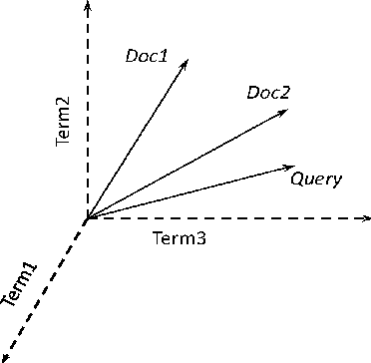

Slide 16
12 Step 4 – Cosine Similarity
Query = [data, retrieval]
Document | Has “data”? | Has “retrieval”? | Similarity
D1 | ✅ | ✅ | Highest (~1.0)
D2 | ✅ | ❌ | Medium (~0.5)
D3 | ❌ | ✅ | Medium (~0.5)

Slide 17
13 Step 5 – Query–Document Matching
Rank | Document | Reason
1 | D1 | Has both “data” & “retrieval”
2 | D2 | Only has “data”
3 | D3 | Only has “retrieval”

Slide 18
Activity – Find the Most Relevant Document
Documents:
D1: data retrieval is important
D2: data analysis and mining
D3: retrieval of information systems
Query: 👉 data mining
Task: 1️⃣ Find which document has “data” 2️⃣ Find which has “mining” 3️⃣ Which document has both words? 4️⃣ That document is most relevant to the query

Slide 19

14 Probabilistic Model
“Ever wondered how your search engines learn
what you really want!” 🤔

Slide 20
15 What is the Probabilistic Model?
This model ranks documents based on the probability that a document is relevant to a given query.
📘 It doesn’t just match words — it estimates how likely a document answers your question.
Formula (optional small): P(Relevant | Document, Query)
💡 Higher probability → Higher ranking

Slide 21
16 How it Works
1️⃣ Initial Guess: The system assumes which words appear in relevant documents. 2️⃣ Compute Probabilities: It calculates for each term — How often it appears in relevant docs (P(k | R)) How often it appears in non-relevant docs (P(k | ¬R)) 3️⃣ Ranking: Documents with higher odds of being relevant are ranked higher. 4️⃣ User Feedback: When users click or mark documents, the system updates probabilities.

Slide 22
17 Bayesian Retrieval
The model uses Bayes’ Theorem to estimate probabilities.
Instead of guessing if a document is relevant
→It computes the probability using previous data

Slide 23
18 Relevance Feedback
The system improves its ranking by learning from user behavior.
Example:
You click fruit pages for “apple” → it learns you mean the fruit.
Most people click iPhone pages → it learns they mean the company.

Slide 24
19 Two Types of Feedback
Type | Description | Example
Explicit Feedback | User marks docs as relevant or not | “Was this helpful?” 👍👎
Implicit Feedback | System tracks clicks, time spent, etc. | You click or scroll more → it learns silently

Slide 25
20 Example: Search “Apple”
1️⃣ You type “apple” 2️⃣ System guesses: most users want Apple company 3️⃣ Ranks Apple.com, iPhone page higher 4️⃣ You click fruit pages 🍏 → system updates your preference 5️⃣ Next time, you get fruit results first
🧠 Learning through Bayesian feedback!

Slide 26
Activity: “Guess & Learn!” – Probabilistic Model 🧠 Query: “Apple”
Doc 1: Apple releases new iPhone 16 with AI camera
Doc 2: Apples are rich in fiber and vitamin C
Doc 3: How to plant apple trees in your backyard
💬 Task: 👉 Pick which docs are relevant to the query.

Slide 27
✅ Boolean Model = “Find exact match” ✅ Vector Space Model = “Find close match” ✅ Probabilistic Model = “Learn best match”
Quick Recap Content

Slide 28

Thank you…
“Ever typed ‘googel’ instead of Google? 😅 Let’s see how IR systems still understand you!”

